Slide 1




Online Student Reviewer Training
Fall 2022
Nicola Scott: nicola.scott@lsc.edu
Jody Ondich: jody.ondich@lsc.edu
Contacts

Slide 2

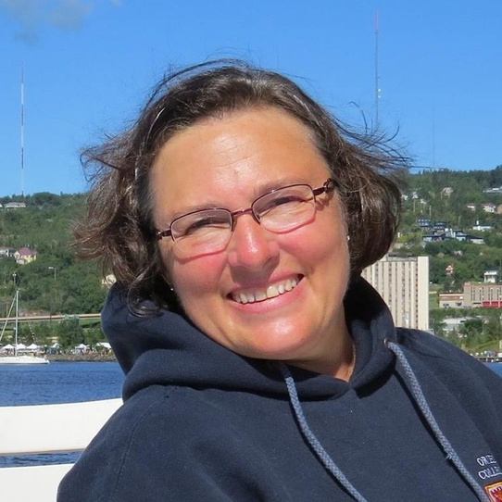
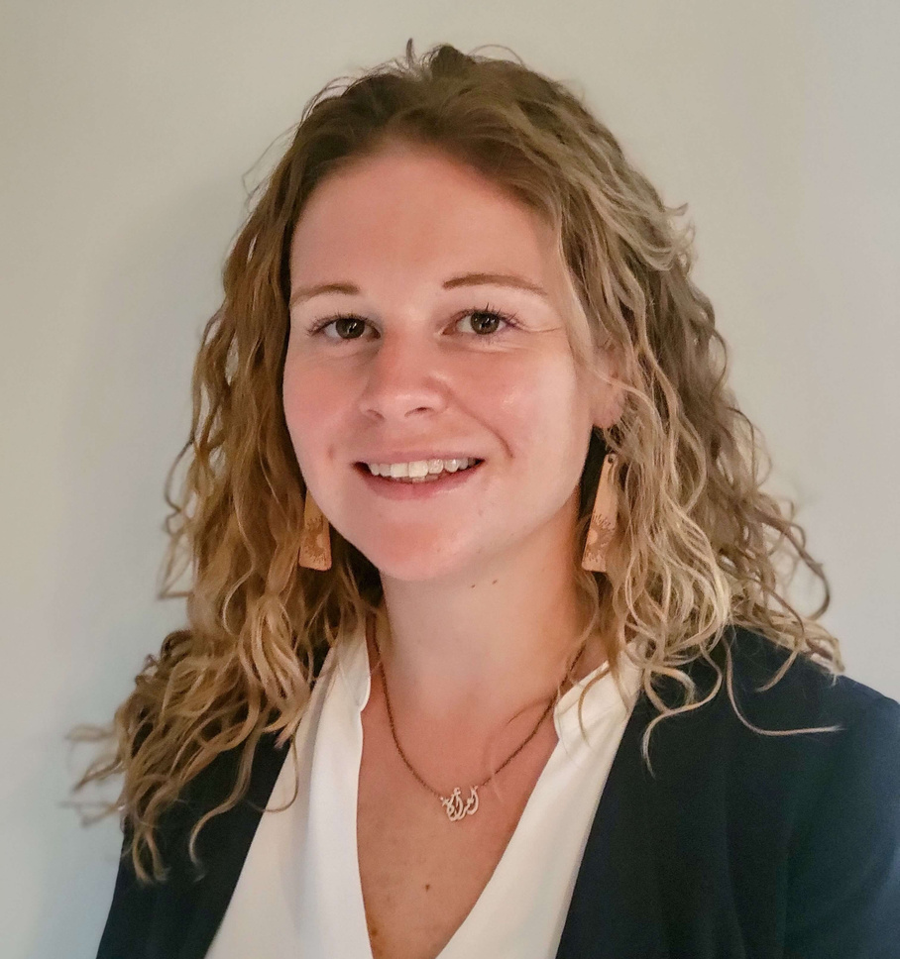

Who We Are
Jody Ondich
Philosophy Instructor and Faculty Development Leader for the Program for Online Excellence in Teaching (POET)
Nicola Scott
Director of the Tutoring and Learning Center
Notes:
Jody Ondich teaches Philosophy at Lake Superior College. She is one of the two faculty development leaders in the college's Program for Online Excellence in Teaching (POET) and serves as the Peer Review coordinator for LSC. She helps facilitate the Coalition for Faculty Support and Innovation Committee on the campus and chaired the accessibility taskforce called Realizing Open and Accessible Design (ROAD) at LSC for 6 years. She has been active in the Minnesota state-wide initiative towards Z degrees, and has written two Open Educational Resource texts, one in 2018 called Words of Wisdom: Intro to Philosophy and the other just finished in October 2021 called World Religions: The Spirit Searching. A third text, Reading the Bible as Literature: a Journey, will be available in fall 2022. These are on the University of Minnesota’s Open Textbook Library site. Jody designed and teaches two accessibility courses for LSC and was one of two designers (and teacher) of the Accessibility Training courses for the Minnesota State system. She also serves on the state-wide Accessibility Committee. When not working, she reads voraciously, plays the piano, sings in a choir, knits and designs knitting patterns, and plays with her 2 orange cats and the family's pup, Rigoletto. The picture is of Jody on their family boat, where she and her husband live in the summer.

Slide 3

Our Mission
1
To improve the student online experience
2
Lift up student voices to make positive changes
3
To provide faculty with tangible feedback

Slide 4
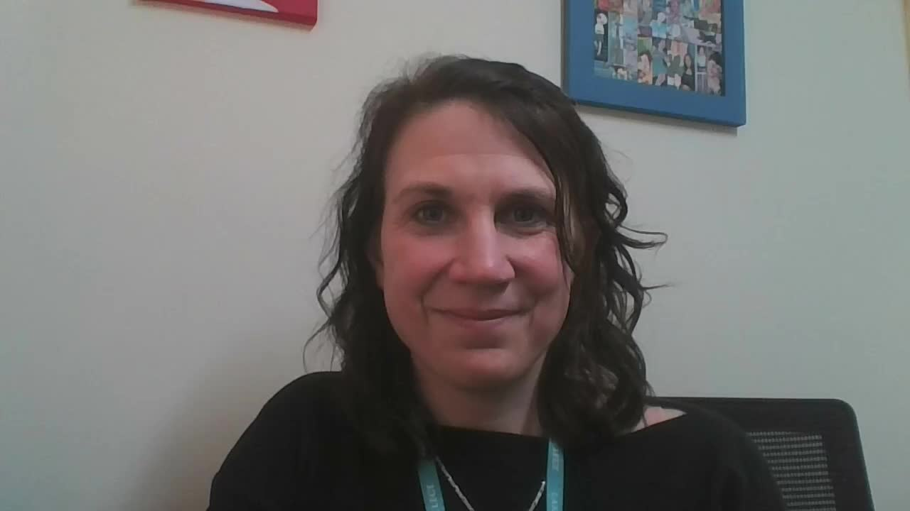
Instructor Feedback

Slide 5

Time Commitment
30-minute initial training
We are doing it now!
Minimum 30-min recorded review
A breakdown will be given shortly
Maximum 30-min recorded interview
Response discussion and follow-up questions
Minimum of two reviews per semester

Slide 6

Compensation
$40 per review
October 21 Paycheck
Improve the online experience for future students
Great addition to your resume
References available upon request

Slide 7

So how does it work?
Sign up to your Student Review time
1
It can take from 2 -12 hrs for the class to be added to your D2L shell
2
Complete a Zoom-recorded review
using the provided rubric (30-mins min)*
3
Schedule your 30-min interview
Meet with Nicola to talk through your review and provided
additional feedback
4
Submit your Student Review Tracking Form
*All Reviews are to be completed in the TLC
Notes:
Location: TLC Study Room
First impressions 2-3 minutes
A few minutes to review the D2L shell and get used to the instructor's layout
Work through the rubric and provide written and/or verbal commentary
Once you have worked through the rubric, review the document and add any afterthoughts or provide more details
3. Meet Nicola and talk through your review (30 mins).
4. Review the review – what worked and what didn’t

Slide 8
Timeline & Scheduling
Between September 7 - October 5
  Sign-up for your first Student Review between Sept 7 - Sept 14*
  Courses may take 2-12 hours to be added to your D2L shell
  Interviews must be scheduled within 24hrs of your review
  Courses will be removed within 12 hours of your interview
*Additional Reviews will be provided upon availability after your initial review is complete
Notes:
Applications for Student Online Reviewer Application closes September 1
Online class Review 30-minute Training to be completed September 6
Classes will be added to your D2L Shell to review on the day of your review
Review the class in the TLC. Arrange this time with Nicola Scott September 6-19

Slide 9
Requirements
  D2L courses may be added to your class list 12 hours before your review is scheduled. Please do not open it until your review
  Record first impressions of the course 2-3 minutes
  Take a few minutes to review the D2L shell and get used to the instructor's layout
  Work through the rubric and provide written and verbal commentary where necessary
  Once you have worked through the rubric, review the document and add any afterthoughts or provide more details
Notes:
Applications for Student Online Reviewer Application closes September 1
Online class Review 30-minute Training to be completed September 6
Classes will be added to your D2L Shell to review on the day of your review
Review the class in the TLC. Arrange this time with Nicola Scott September 6-19

Slide 10
Expectations
  Provide honest feedback about the class navigation and user experience
  Answer all questions fully
  Where possible, provide reasonings for your responses
  The screen should be recording while reviewing the class
Reminder: This is not a review of class content or whether you'd like to take this class
Notes:
Review
Screen and camera recording
Student Online Class Review – 1 hour 30 minutes
Location: TLC Study Room
First impressions 2-3 minutes
A few minutes to review the D2L shell and get used to the instructor's layout
Work through the rubric and provide written and/or verbal commentary
Once you have worked through the rubric, review the document and add any afterthoughts or provide more details
Meet Nicola and talk through your review (30 mins).
Review the review – what worked and what didn’t
Complete signature card and submit for payment.
If you finish your review with plenty of time to spare – you are not providing enough information!

Slide 11


If you finish your review with plenty of time to spare – you are not providing enough information!

Slide 12
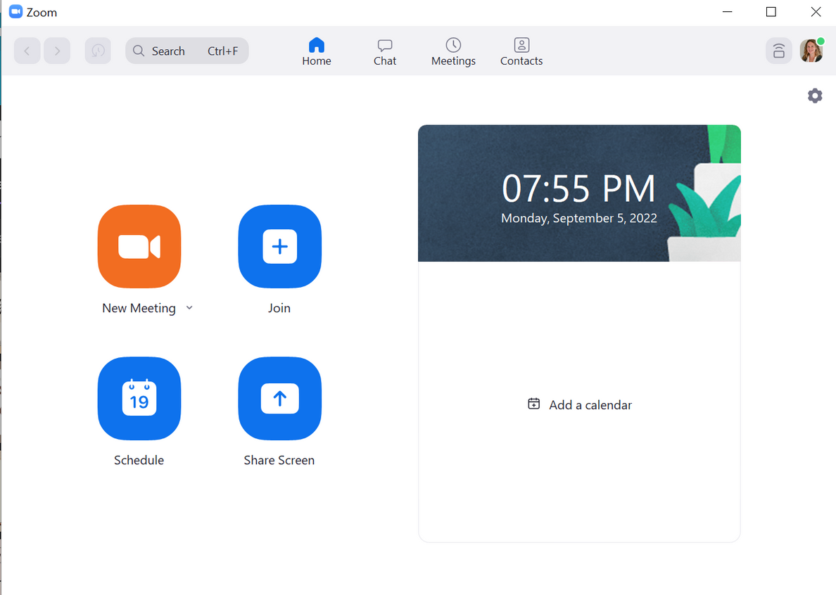

Student Review: Set-up
2
3
1

Slide 13

Student Review: Set-up

Slide 14
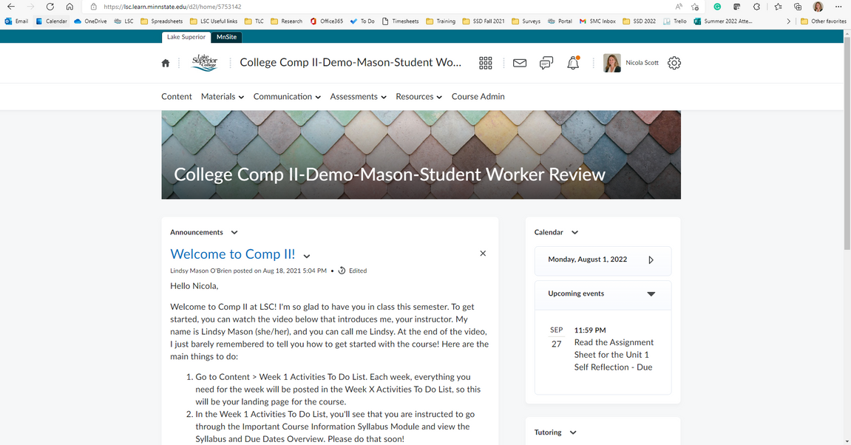
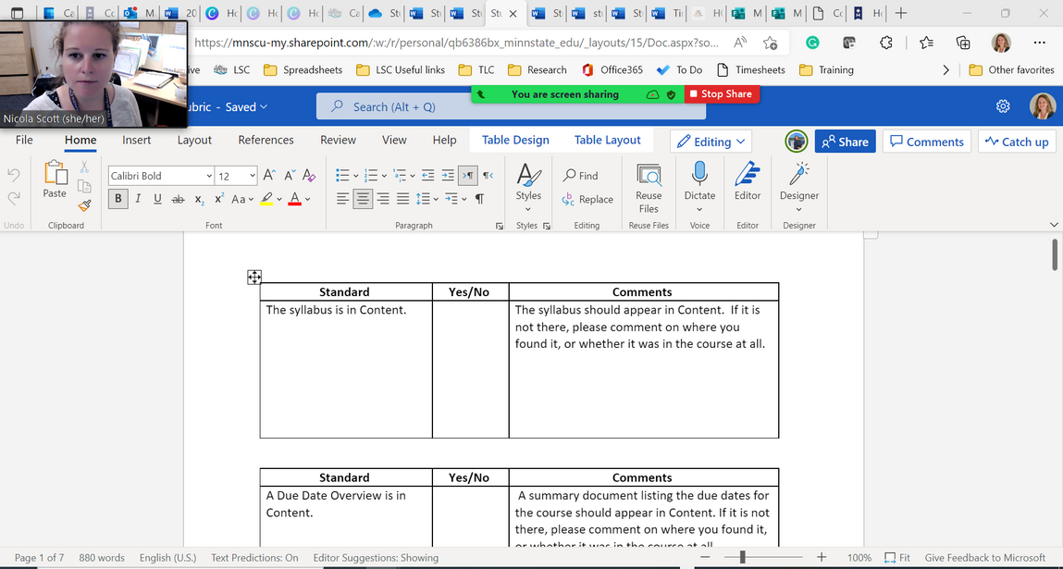
Student Review Set-up cont.
Screen 1
Screen 2

Slide 15

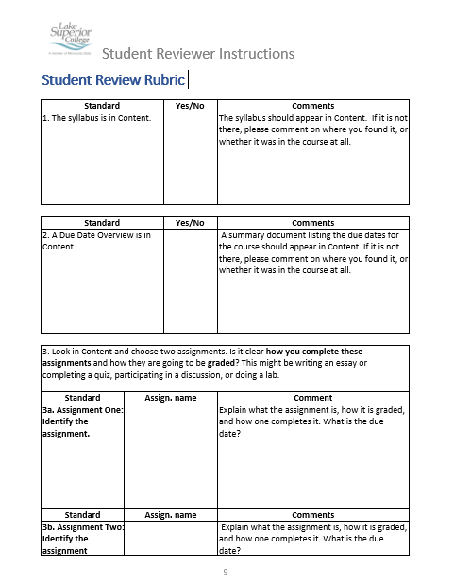
Student Review Set-up cont.
Screen 1

Slide 16
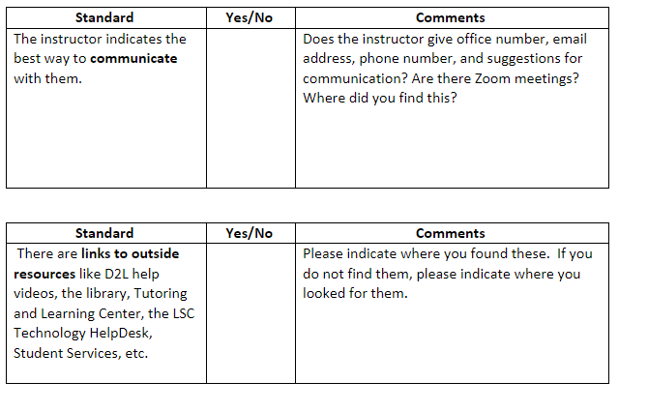
Rubric
Note: This box size increases as you type!

Slide 17
Comments
Notes:
Handout in Envelope
No
I found the Zoom link to the class, however the instructor

Slide 18
A note about indentifiers
They/Their/Theirs provides anonymity
The instructor, or This class
Focus on contructive feedback. Be honest, but be respectful!
Notes:
Handout in Envelope
No
I found the Zoom link to the class, however the instructor

Slide 19
Rubric Comments
We are looking for both subjective and objective comments!
But, be sure to delve deeper into why you feel the way you do about a particular feature of the class!
Notes:
Handout in Envelope
No
I found the Zoom link to the class, however the instructor

Slide 20
Rubric Comments: Subjective
Subjective comments
The class was good.
The course used a layout that was logical to me and allowed me to follow the course. This would help me keep track of due dates and assignment requirements.
I didn't like the font colors.
I found the font difficult to read and overcrowded. The font color didn't contrast the background enough and so hurt my eyes after reading it for a while. There was too much to read and wasn't separated by headings. .
Notes:
Handout in Envelope
No
I found the Zoom link to the class, however the instructor

Slide 21




Questions?Thank You

