Slide 1
Career Exploration
Learn about the tools and resources that are available to you to help aid in your career journey.
Kaitlyn Taggart
Director of Career Services
Lake Superior College

Slide 2
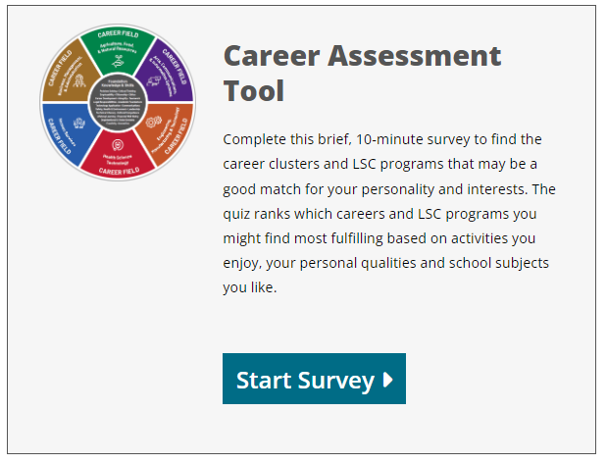
Career Assessment Tool
https://www.lsc.edu/current-students/career-services/career-planning/

Slide 3
Resources
MN State Career Exploration – Assessments, exploration and goal-setting tools.
CAREERwise – Research careers, complete assessments and create a career plan
Career Planning Workbook
DEED – MN Dept of Employment and Economic Development. Career Profiles include wages, demand, job opportunities, and more!

Slide 4
Career Services
Lake Superior College
LSC Student Services (S-Building)
careerservices@lsc.edu
218-733-7623
www.lsc.edu/careerservices
Thank you!

